Slide 1
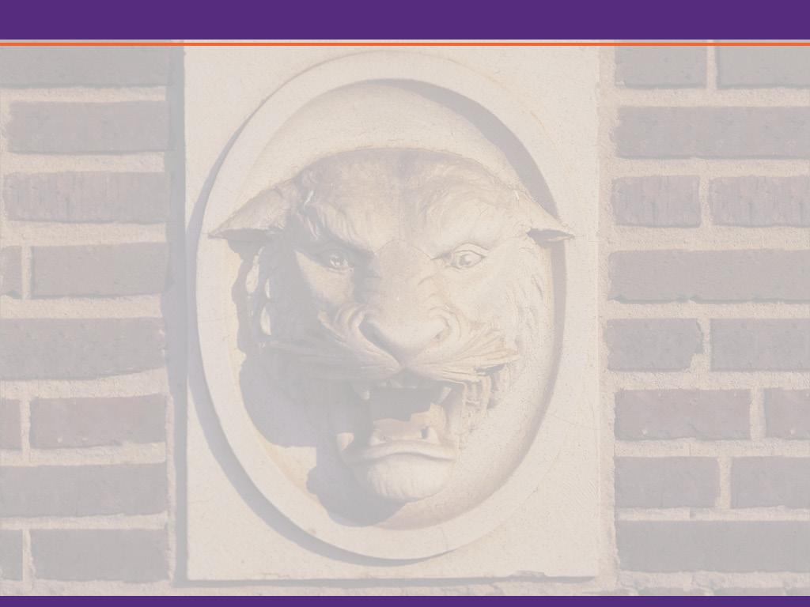


Autonomous Navigation on Road
AuE 8240 Autonomous Driving Technologies
Team:​ | Group - 2
Term Course:​ | Spring 2022​
Team Members:​ | Mayuresh Bhosale Siddharth Thorat Siva Jyothi Karna Zongming Yang

Slide 2
Project Overview
Hardware installation
Camera calibration
Basic intrinsics & extrinsics
Radial distortion
Lane extraction
Image capture
Edge detection
Lane extraction
Lane tracking
Tracking control
Speed and Steering control
Loop control for vehicle speed manipulation
Sign recognition
Data augmentation
Cascade detection
Deep learning

Slide 3
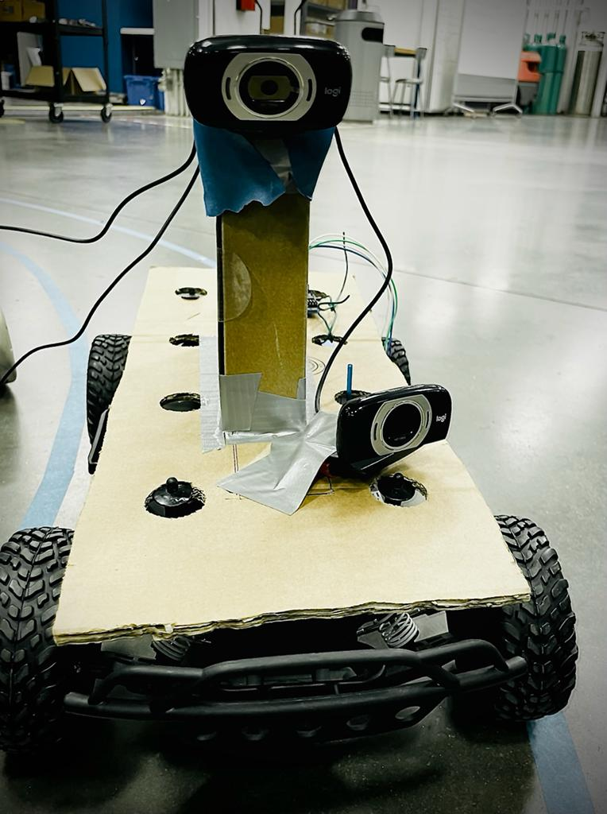
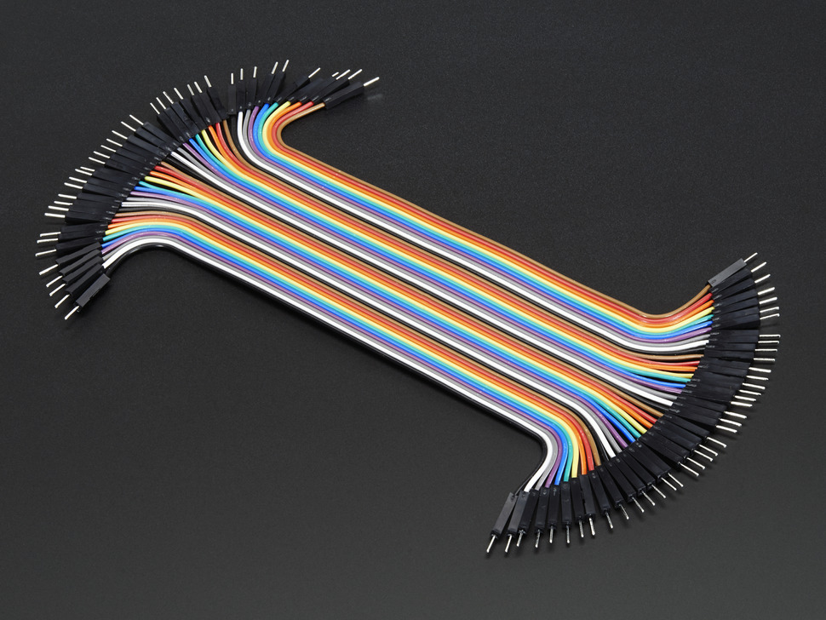
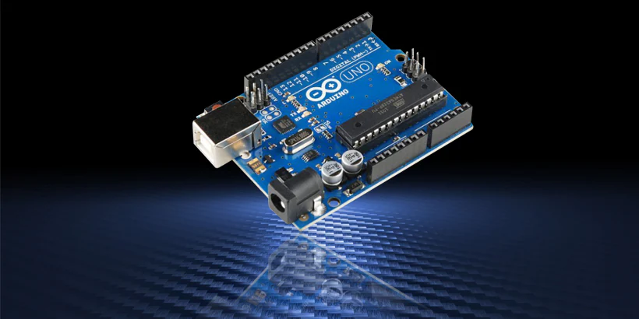
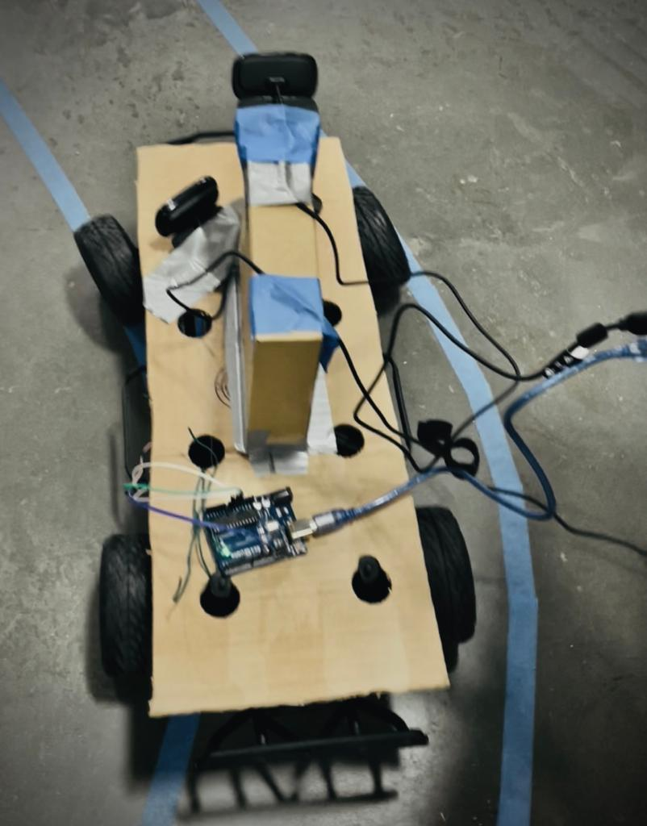
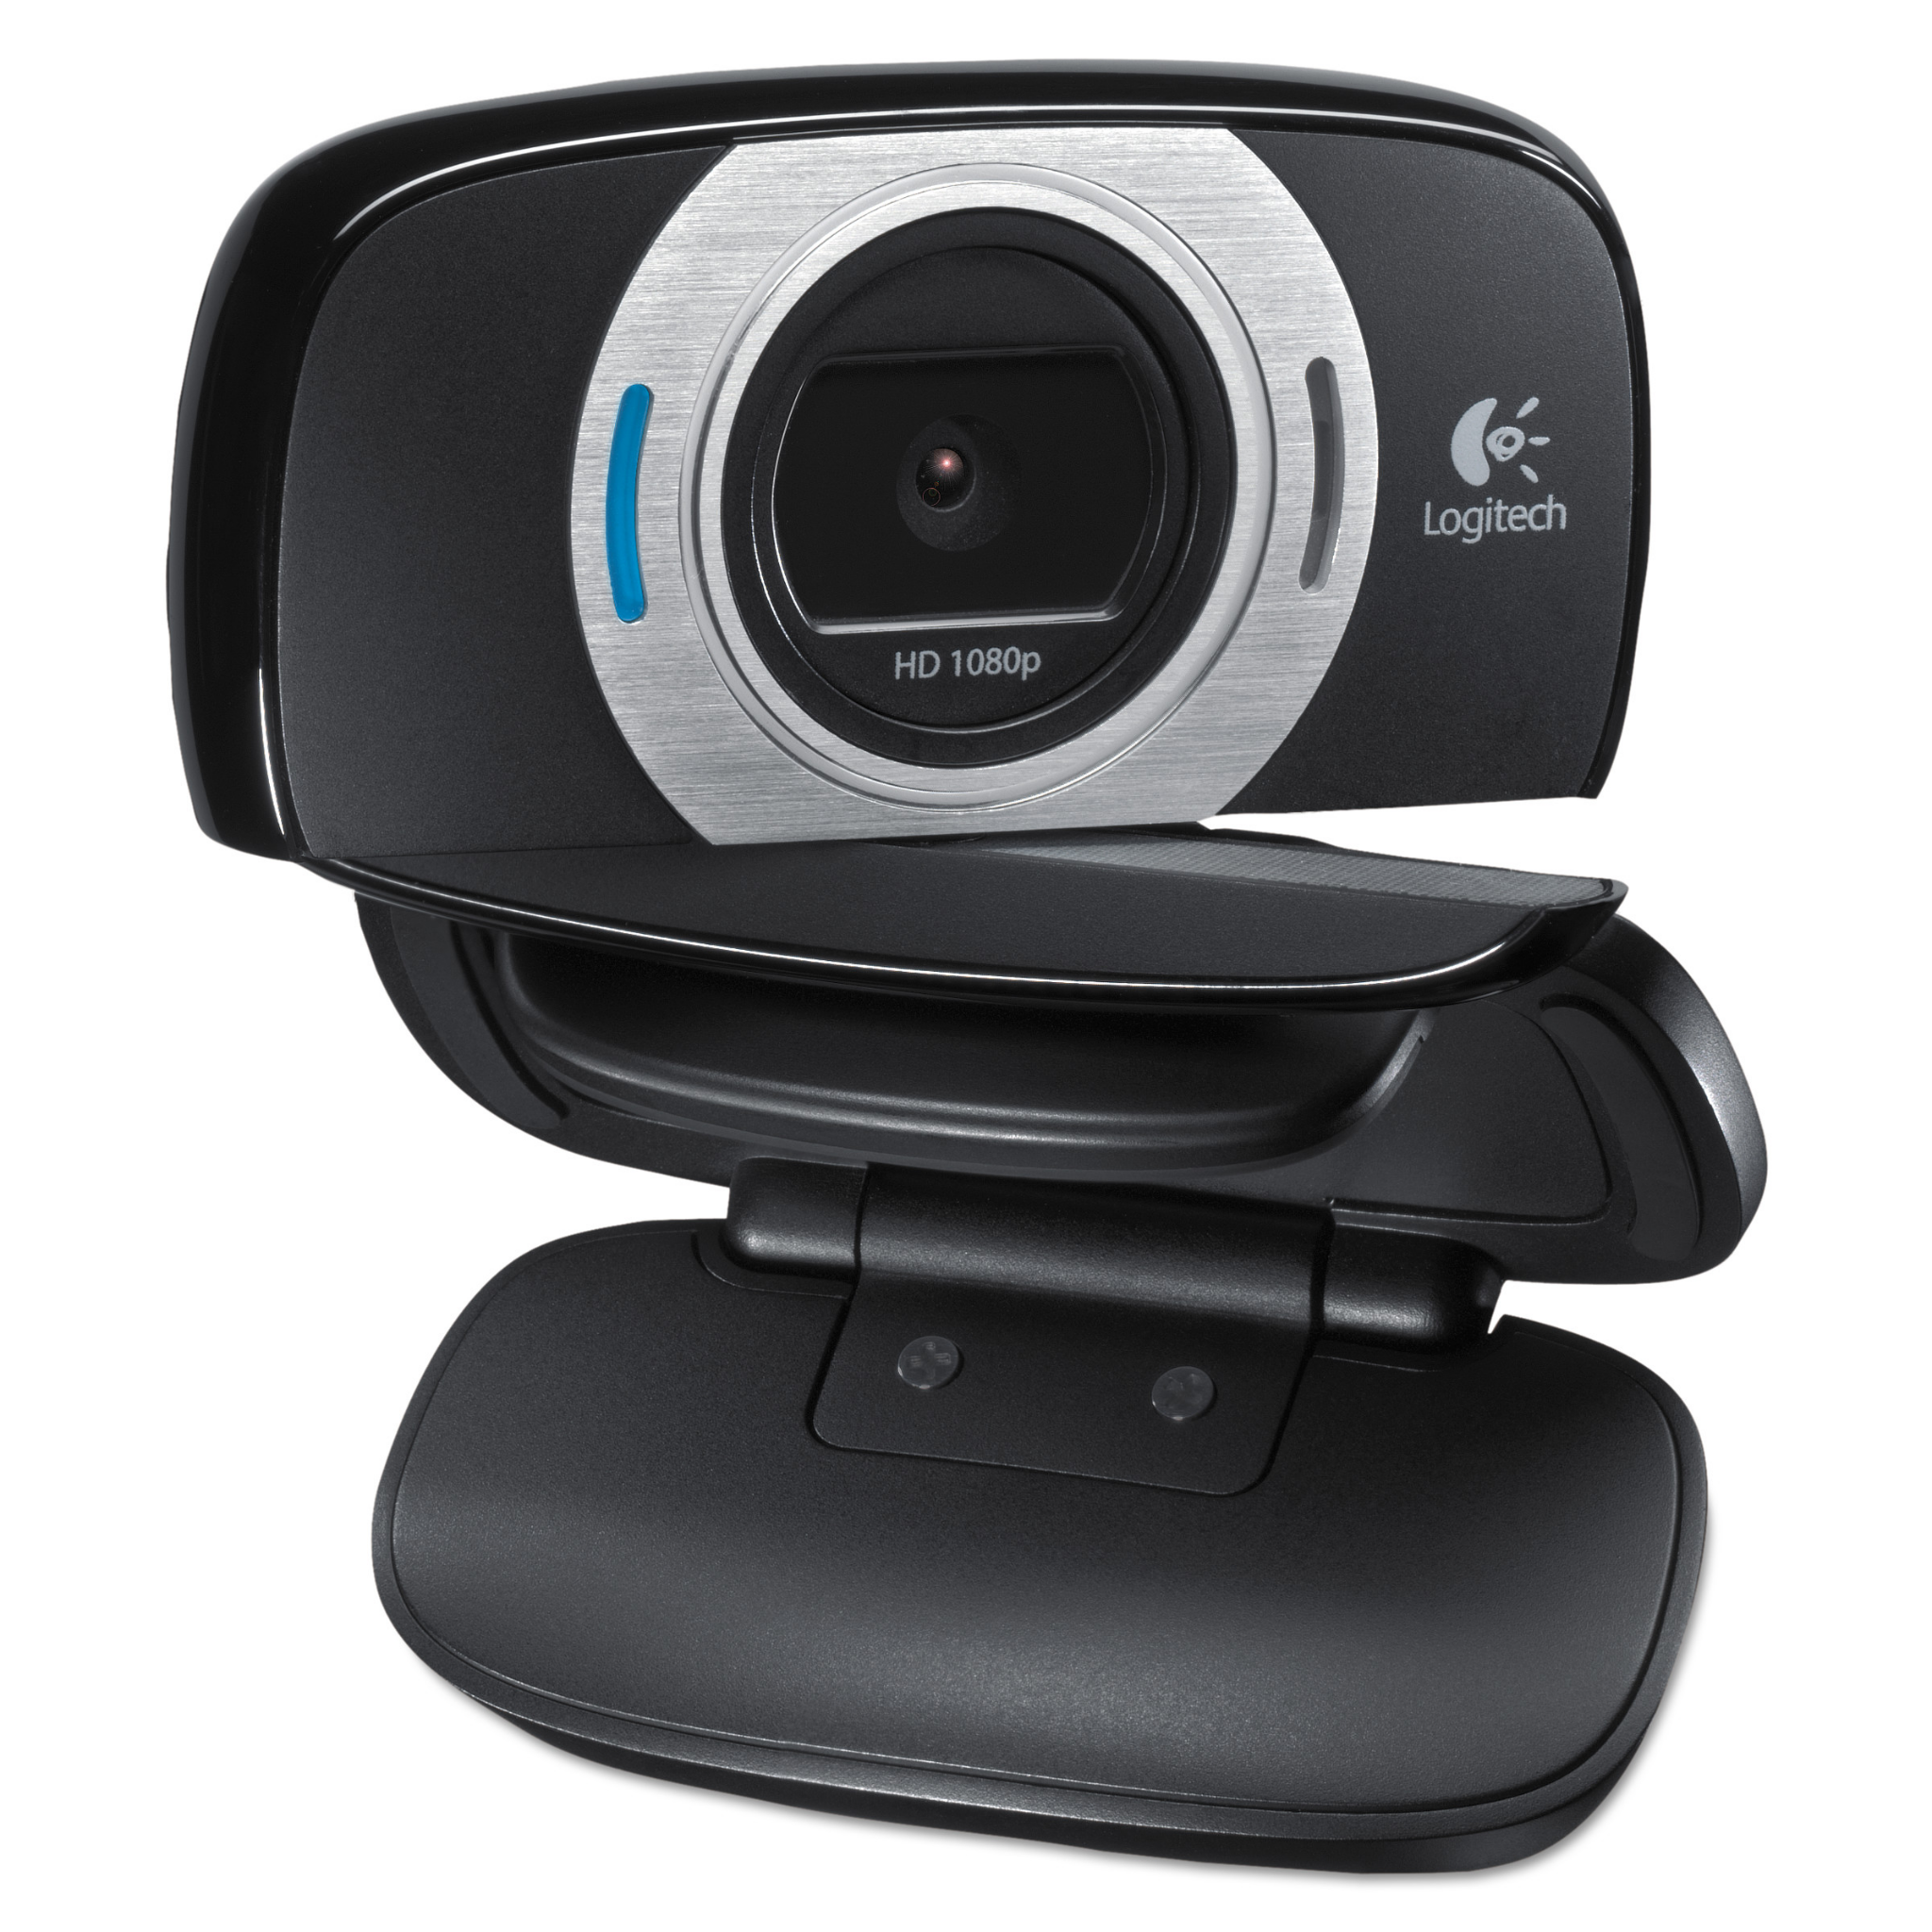
Hardware Installation…
RC vehicle (car)
Arduino kit
Logitech Cameras -2
Jumper wires

Slide 4
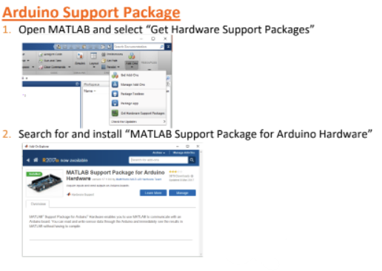
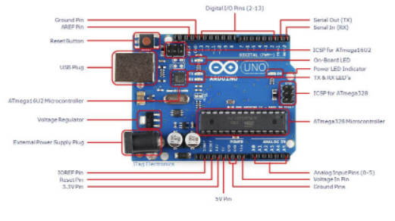
Arduino Setup

Slide 5
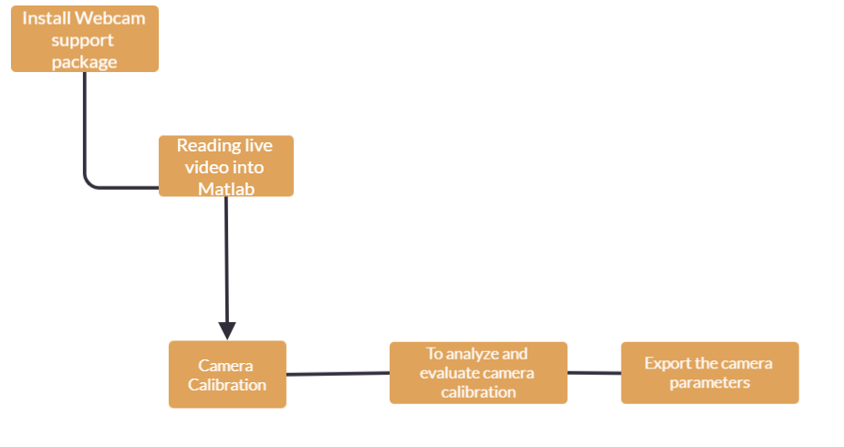
Camera Setup

Slide 6
Lane Extraction
Image capture
Camera parameters
Camera position
Edge detection
Edge detection method
Rgb merge
Image rescale
Denoise
Gamma correction
Histogram equalization
Lane extraction
Hough line transformation
Line segments merge

Slide 7
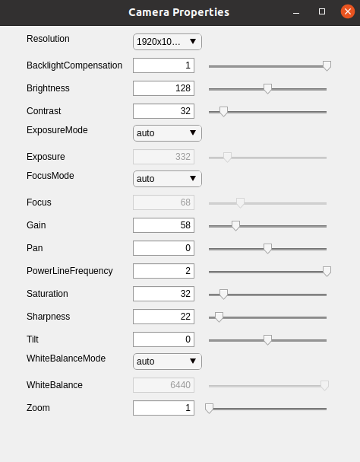
Camera Parameters
Resolution: 640x480
Exposure Time: -7 (Win10), 52 (Ubuntu)
Focal Length: 53

Slide 8
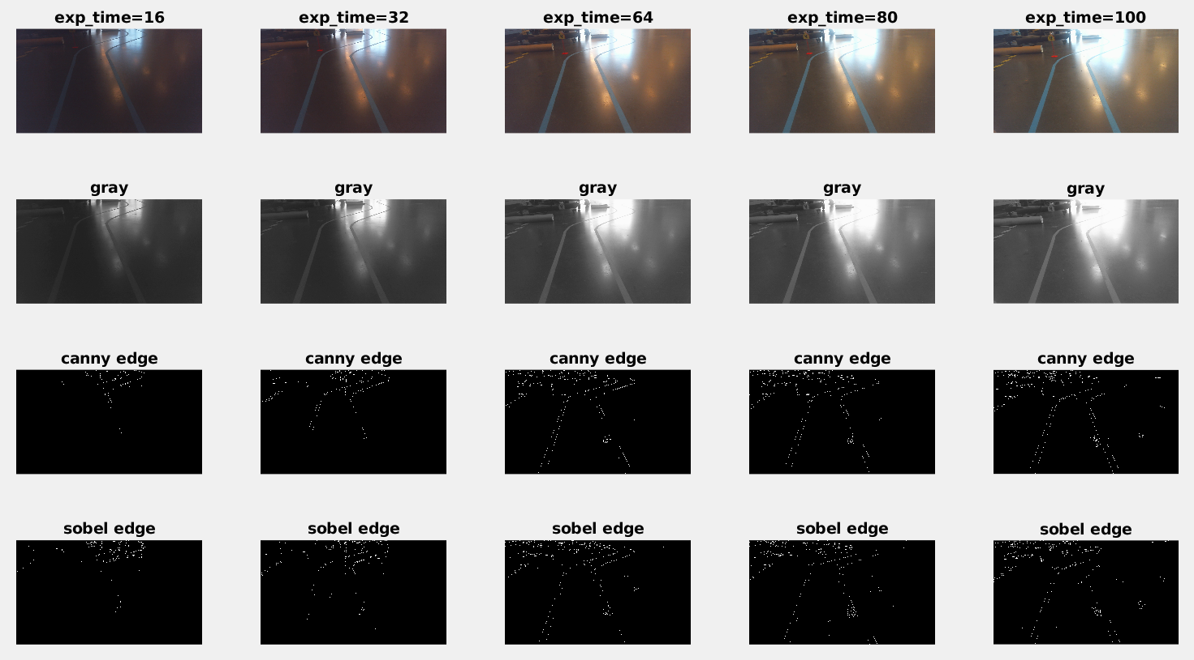
Exposure Time

Slide 9
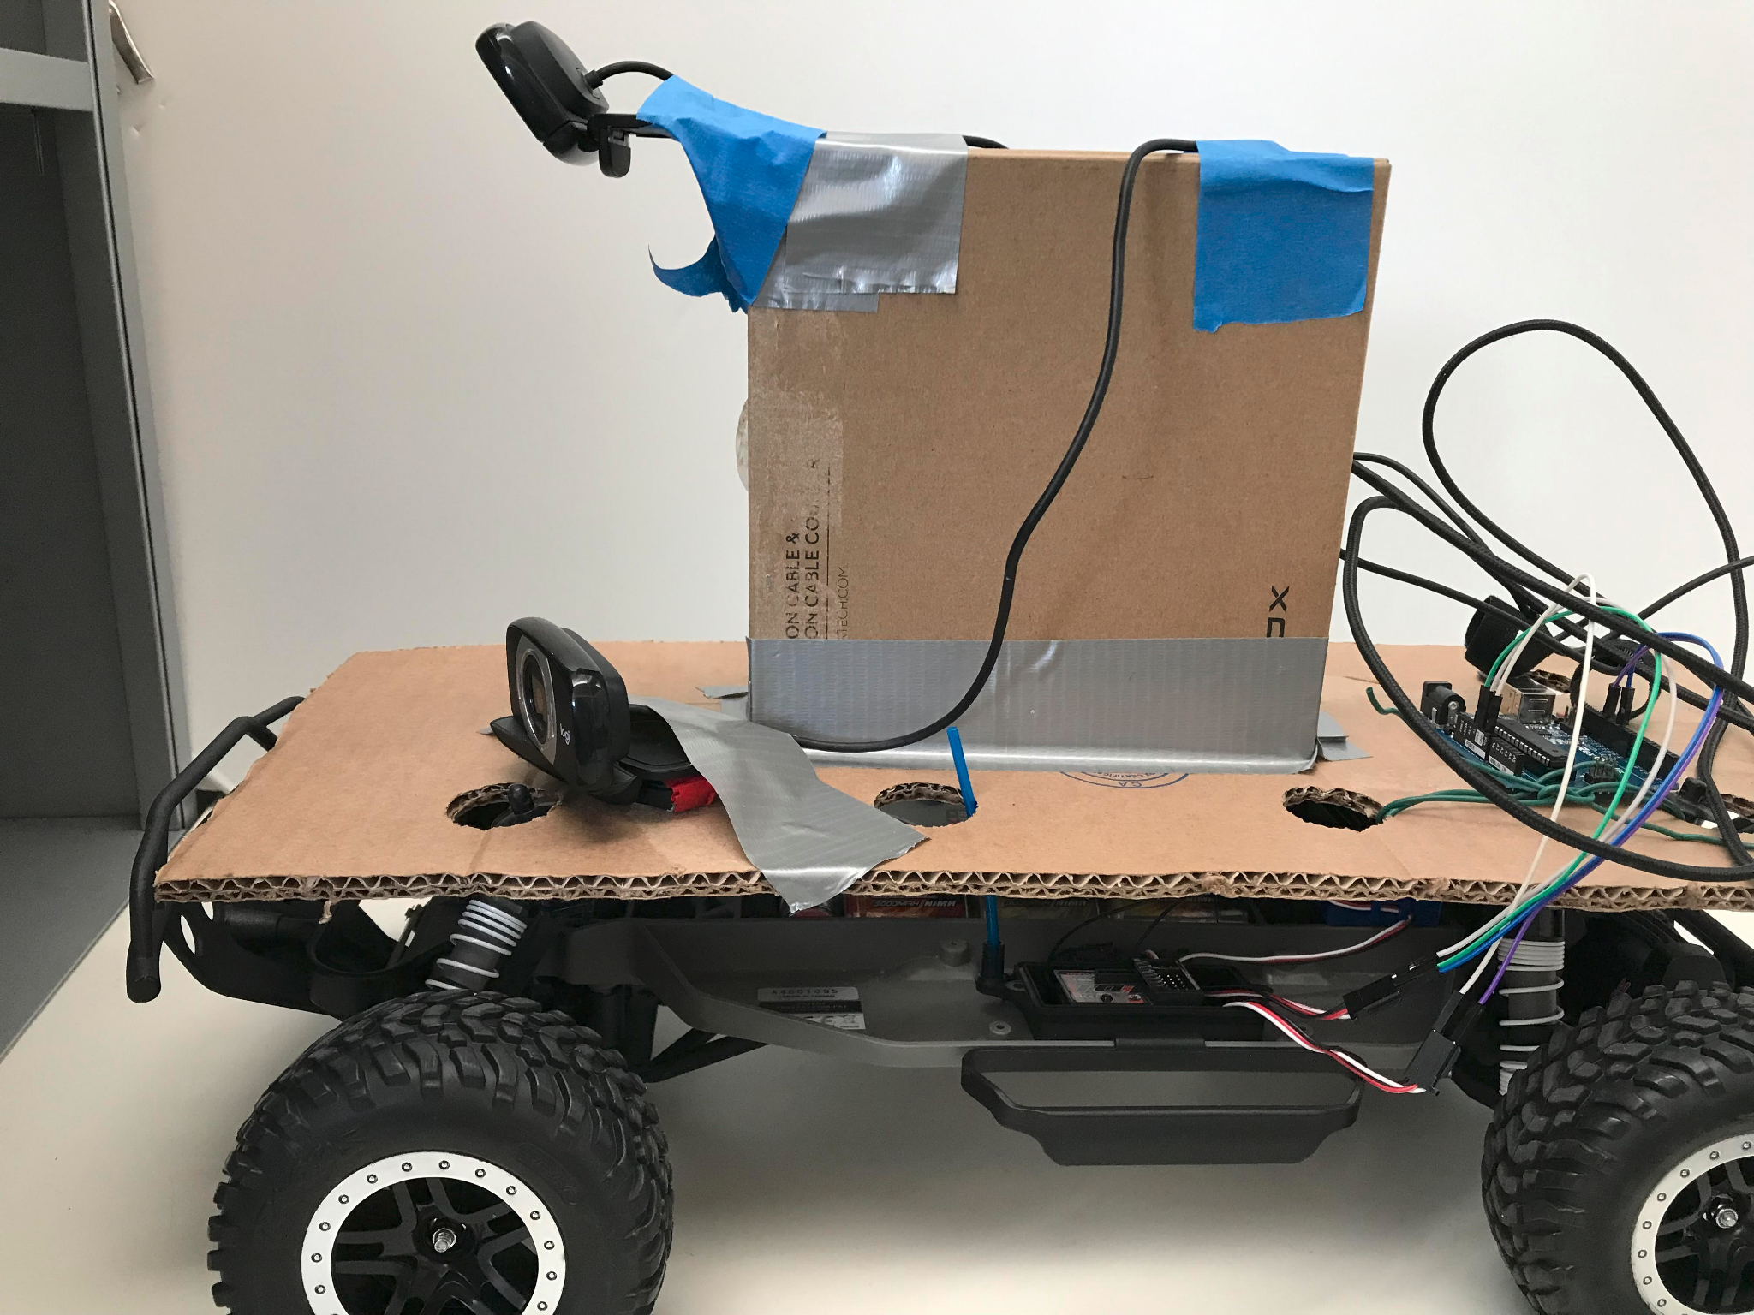
Camera Position
Front-top
Front-low
back-top

Slide 10
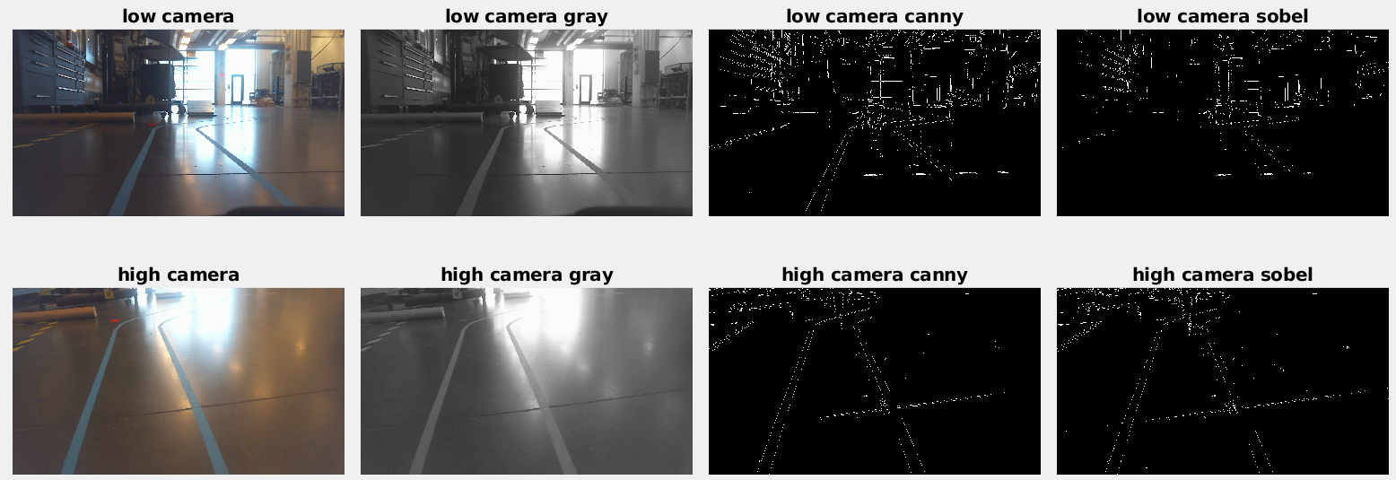
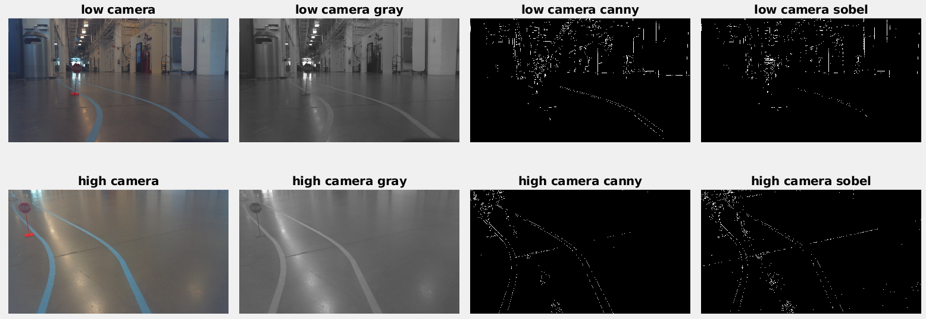
Top vs. Low
Top vs. Low

Slide 11
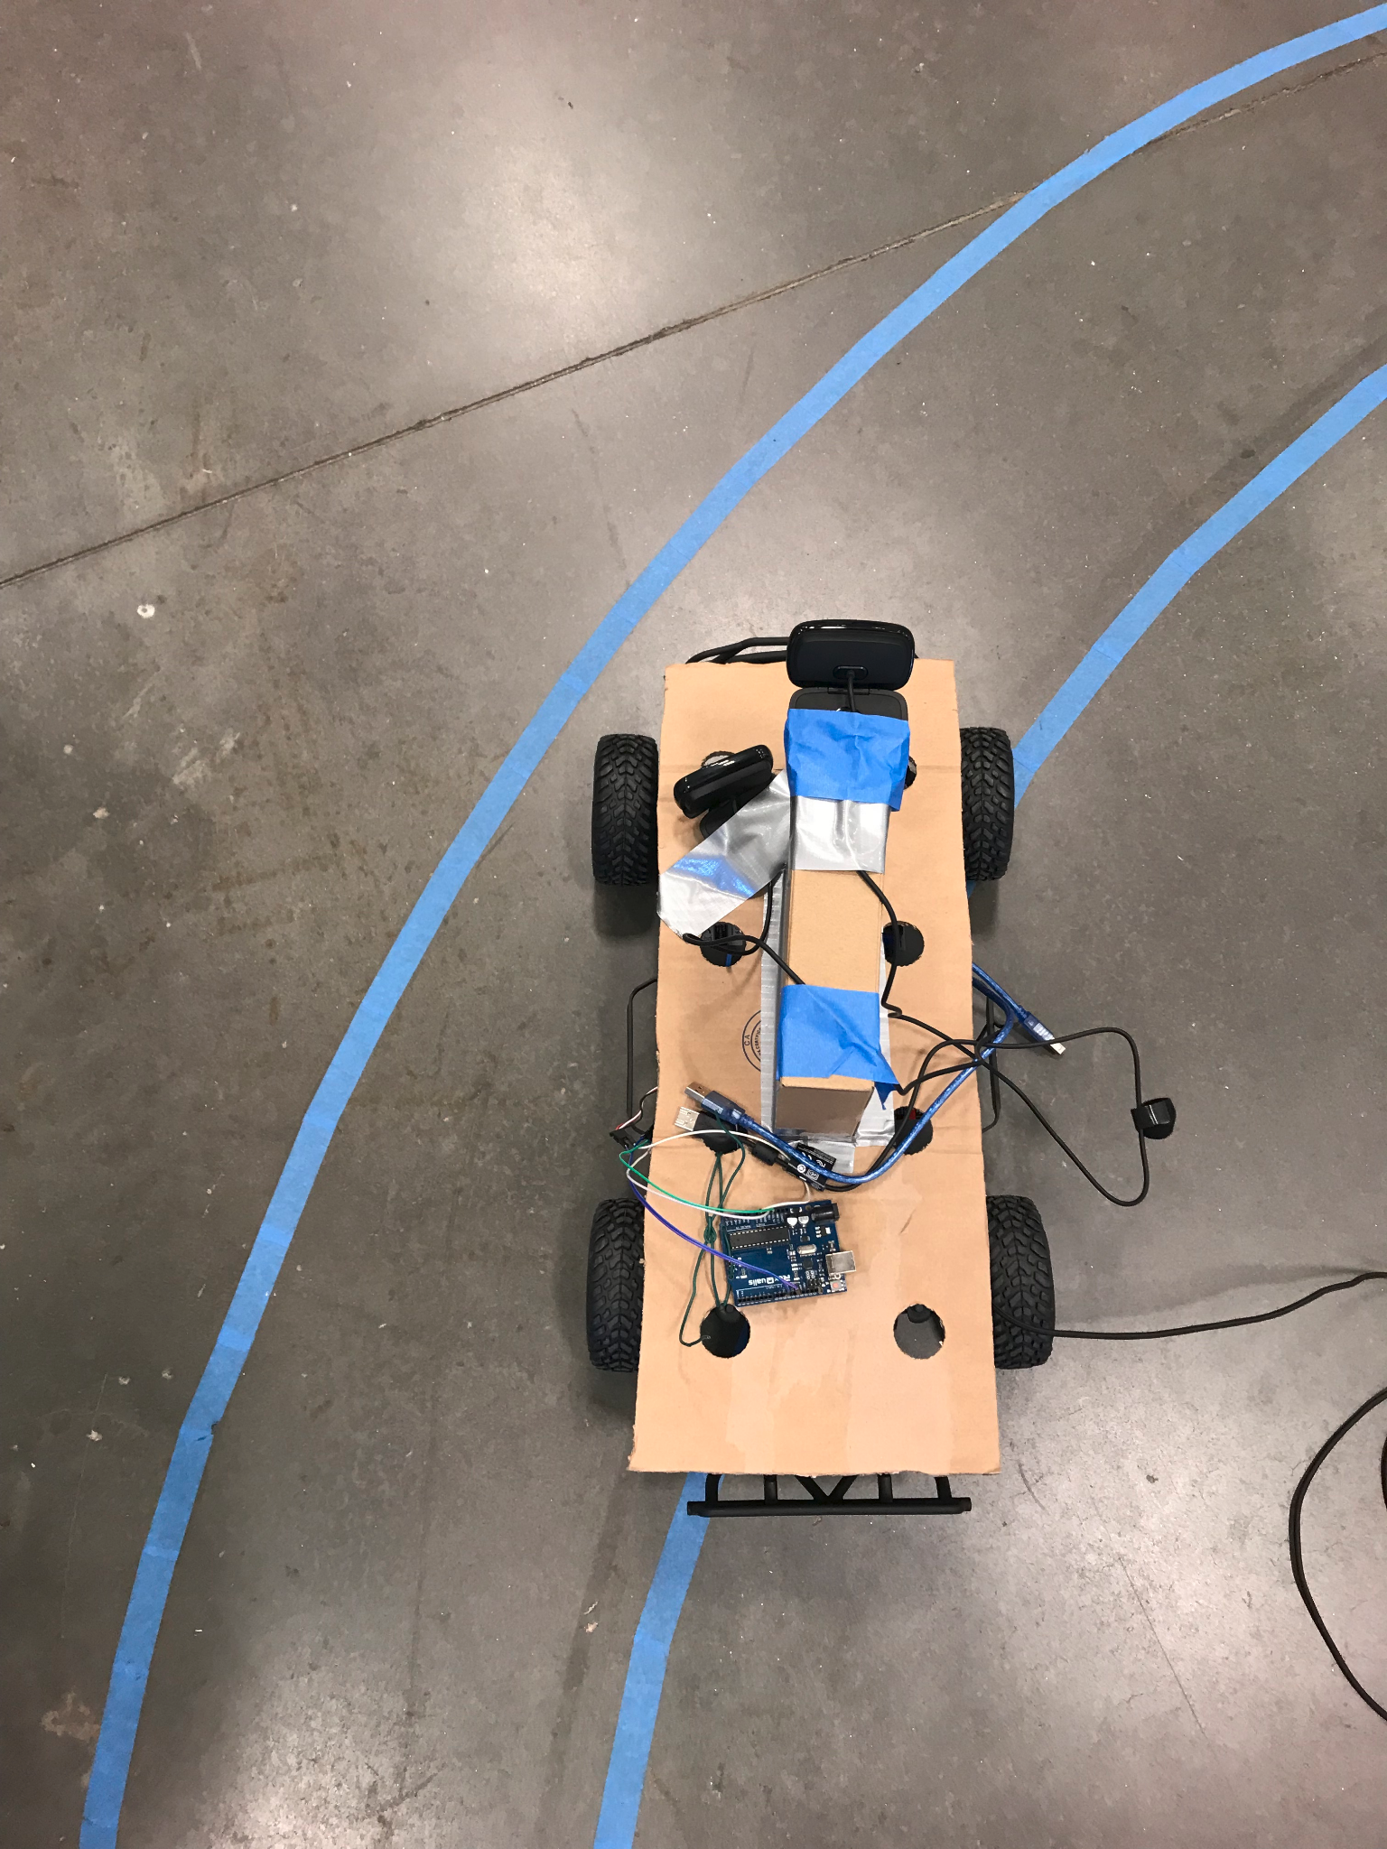
Front vs Back

Slide 12
Edge Detection
Edge detection method
Rgb merge
Image rescale
Denoise
Gamma correction
Histogram equalization

Slide 13
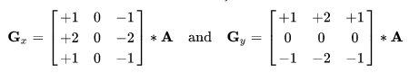
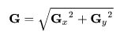
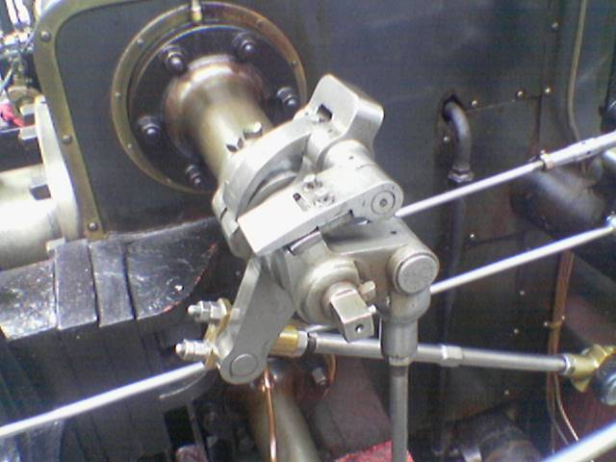
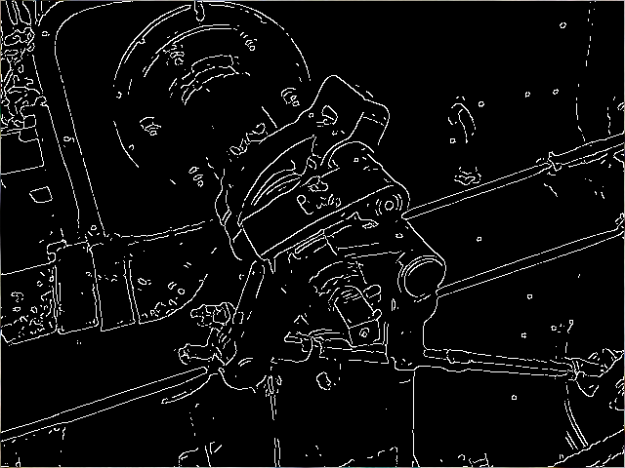
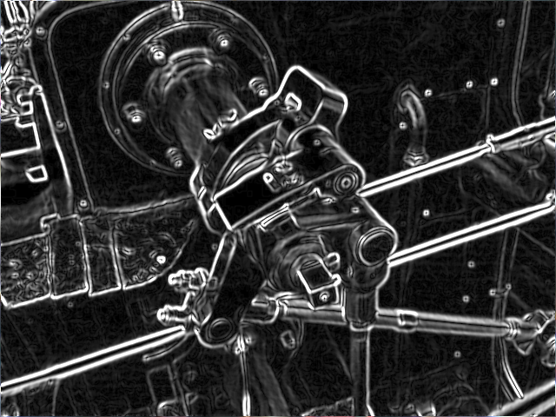
Edge detection method
Canny detector:
Apply Gaussian filter to smooth the image in order to remove the noise
Find the intensity gradients of the image
Apply gradient magnitude thresholding or lower bound cut-off suppression to get rid of spurious response to edge detection
Apply double threshold to determine potential edges
Track edge by hysteresis: Finalize the detection of edges by suppressing all the other edges that are weak and not connected to strong edges.
https://en.wikipedia.org/wiki/Canny_edge_detector
Sobel operator:

Slide 14
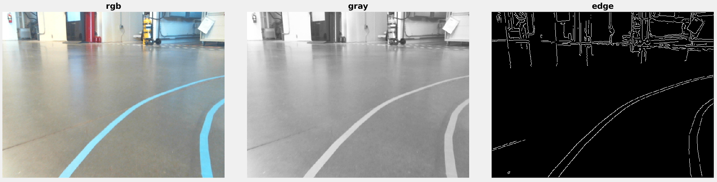
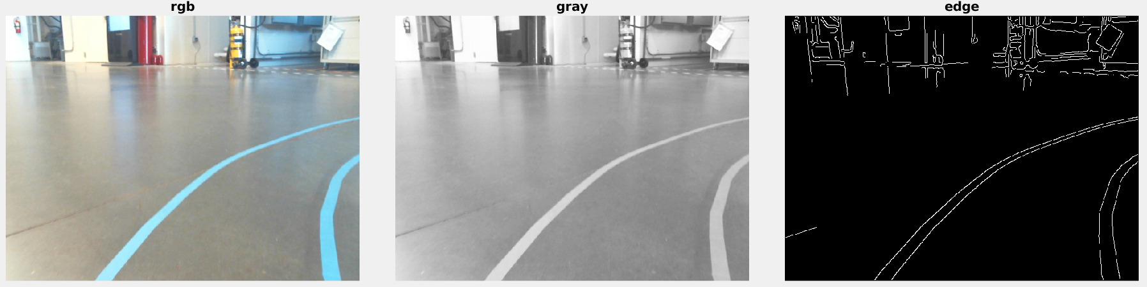
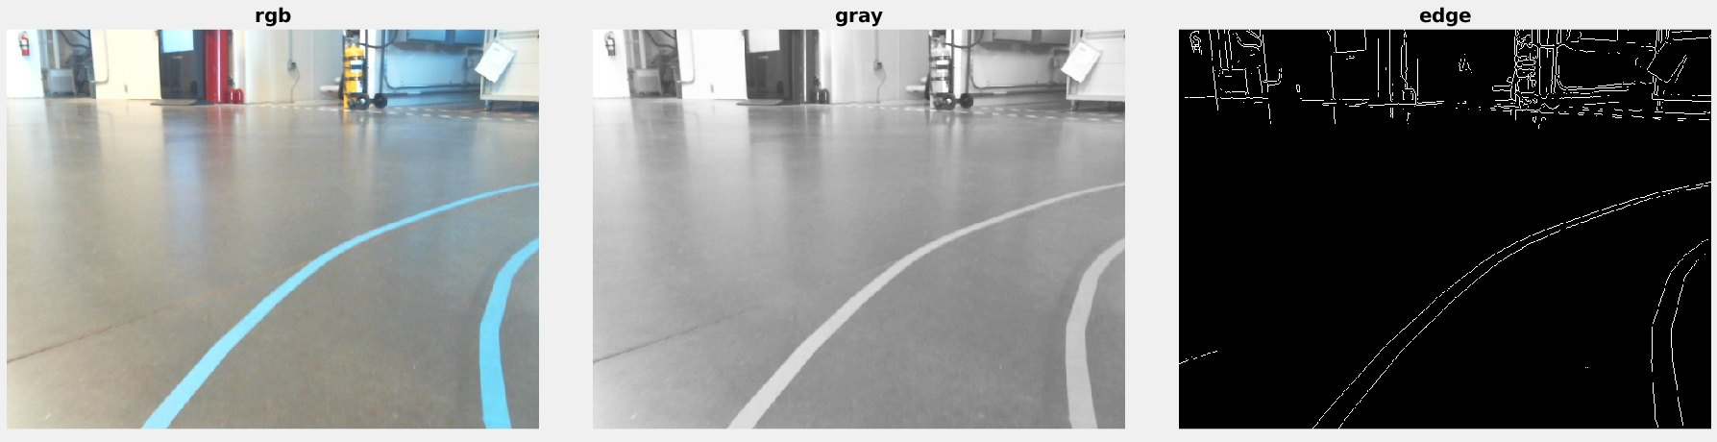
Canny vs. Sobel
canny,[0.05,0.1]
canny,[0.1,0.2]
sobel
Notes:
4650113442

Slide 15
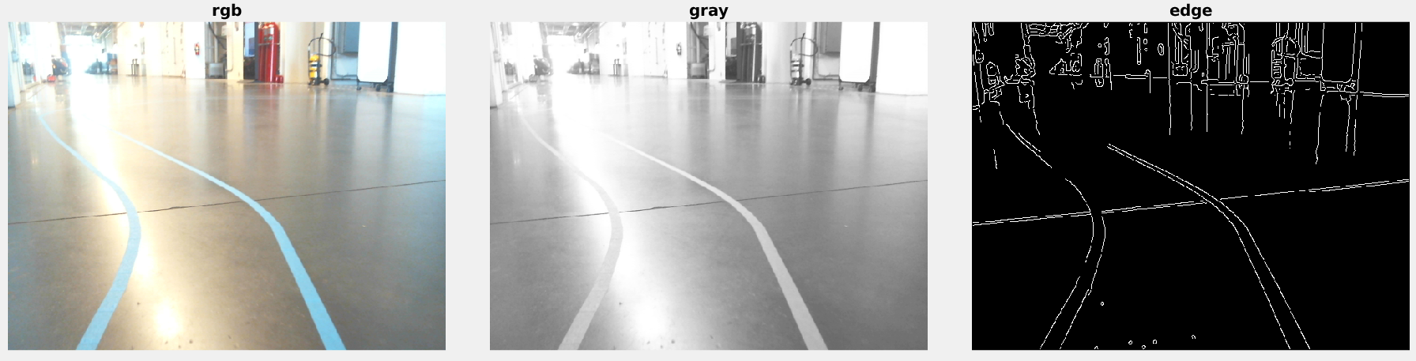
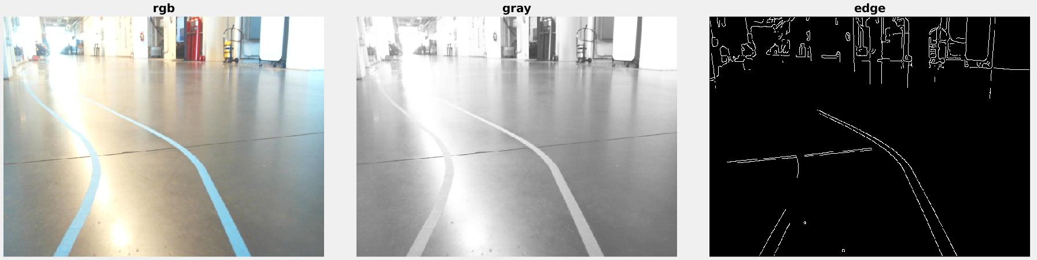
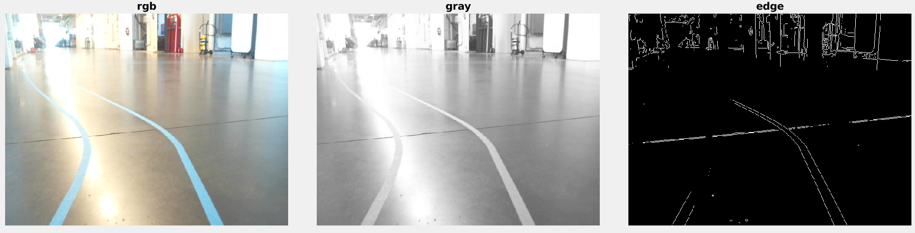
Canny vs. Sobel
canny,[0.05,0.1]
canny,[0.1,0.2]
sobel
Notes:
4650113442

Slide 16
Canny vs. Sobel
Result on: AMD® Ryzen 5 5600h with radeon graphics × 12, 32GB memory
process 106 imgs, repeat 100 times, total 10600 run for each method:
Type | Time [s] | FPS
Sobel | 0.001264 | 791
Canny [0.05,0.1] | 0.007790 | 128
Canny [0.1,0.2] | 0.007525 | 132

Slide 17
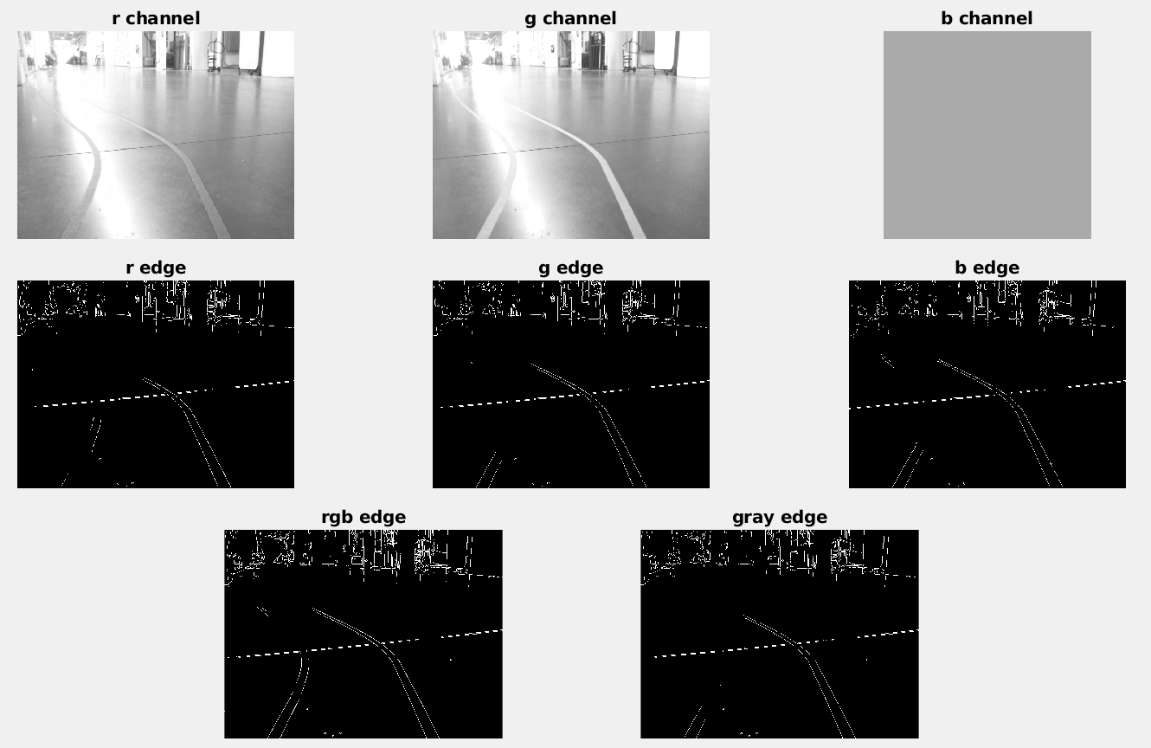
RGB merge
Sobel

Slide 18
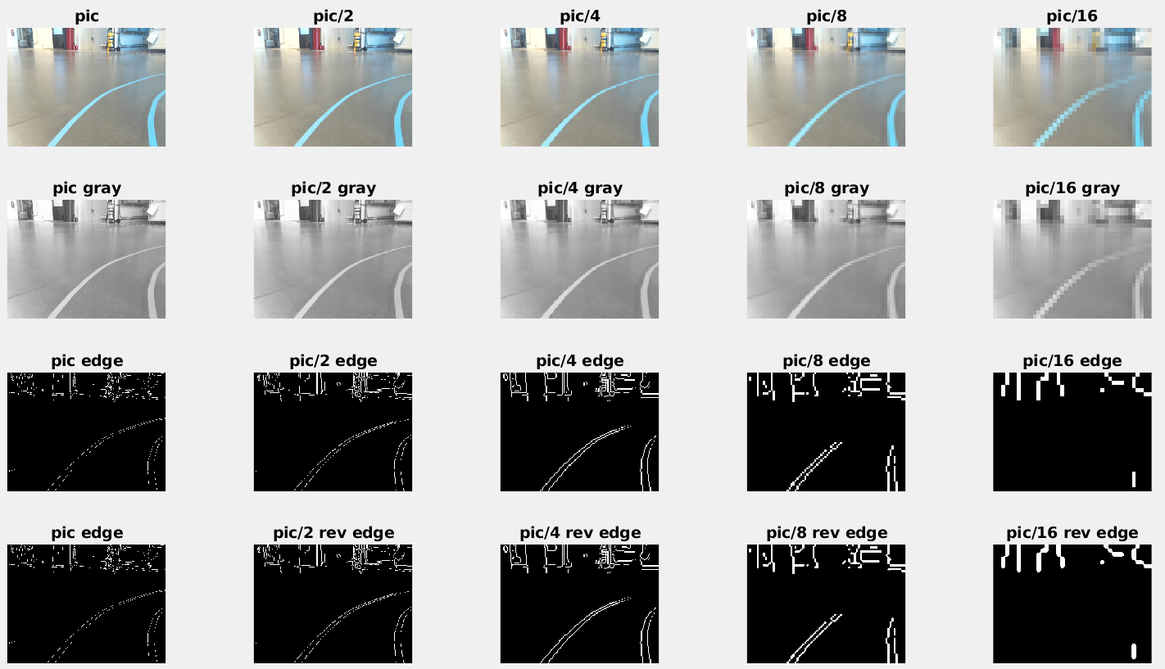
Image rescale
640x480
320x240
160x120
80x60
40x30
Sobel

Slide 19
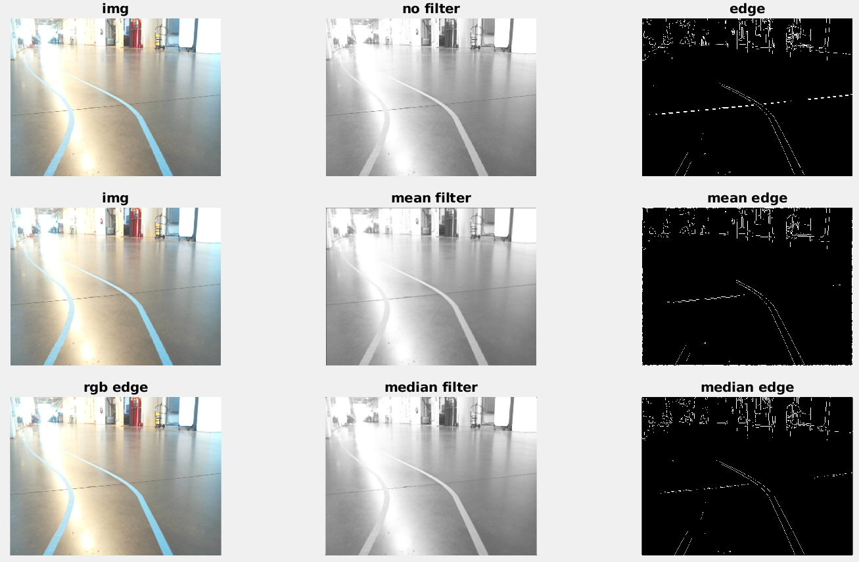
Denoise

Slide 20
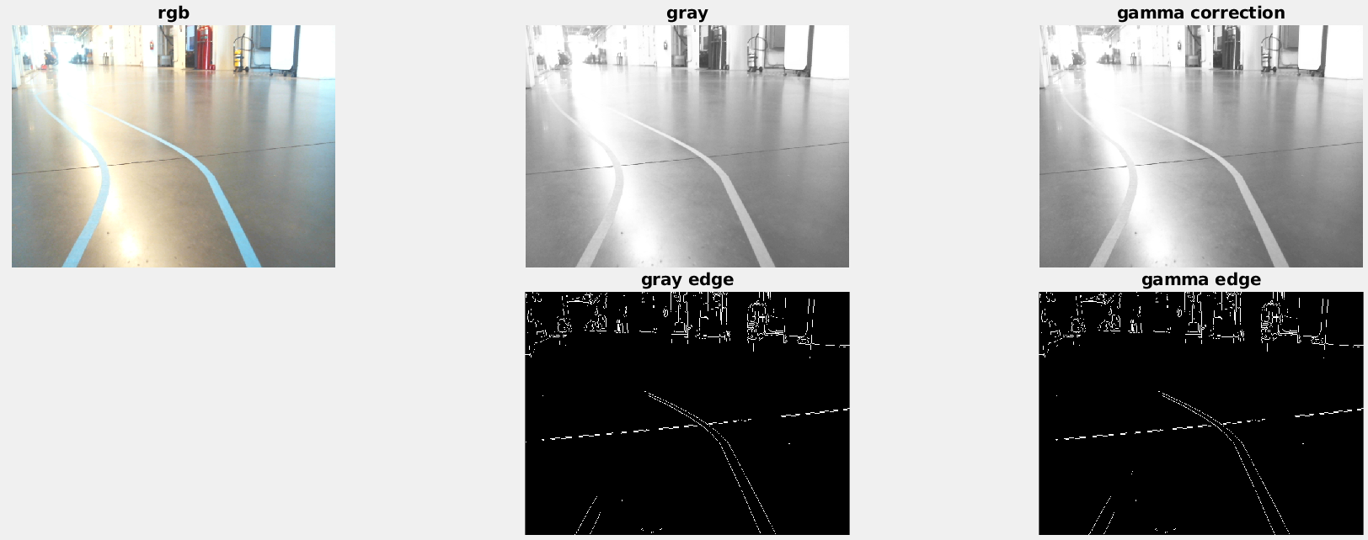
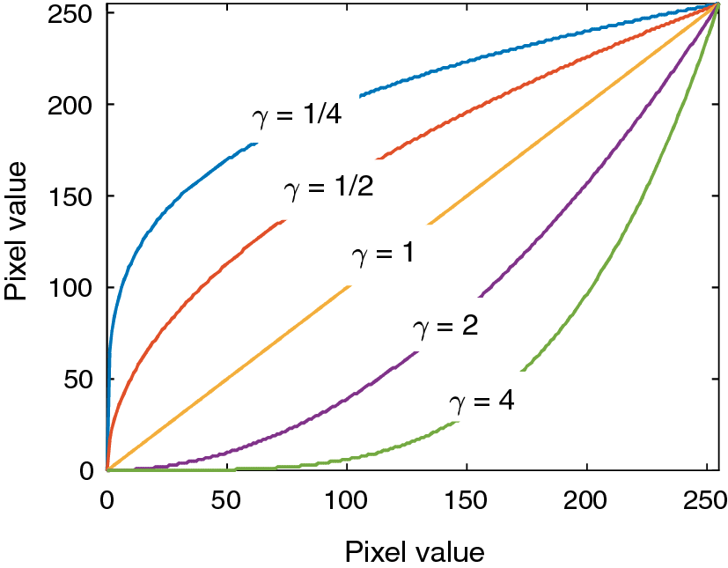
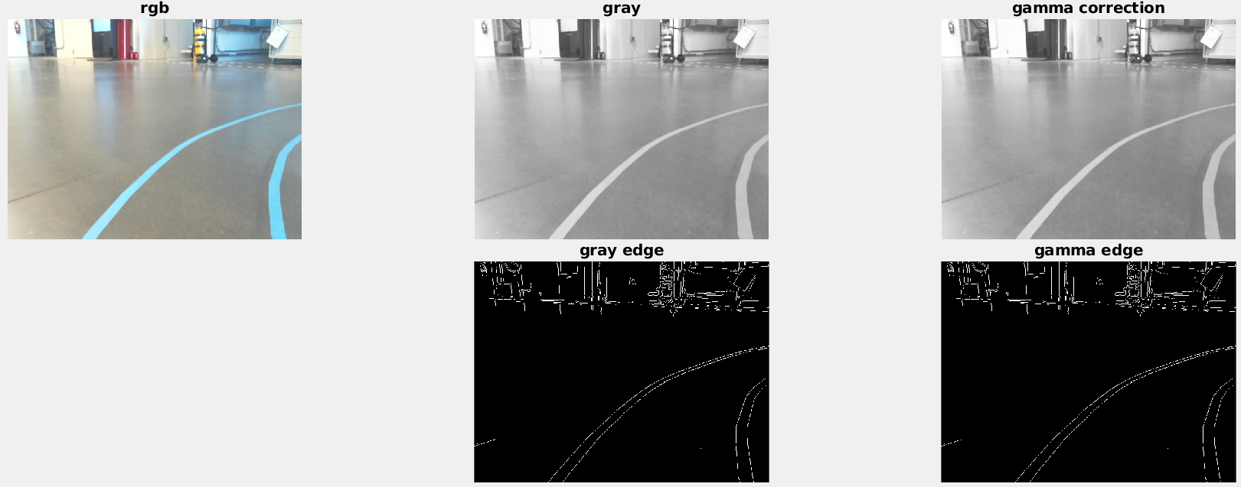
Gamma correction
An improved luminosity and contrast enhancement framework for feature preservation in color fundus images - Scientific Figure on ResearchGate. Available from: https://www.researchgate.net/figure/Gamma-correction-curve-for-different-values-of-gdocumentclass12ptminimal_fig2_329571120 [accessed 27 Apr, 2022]

Slide 21
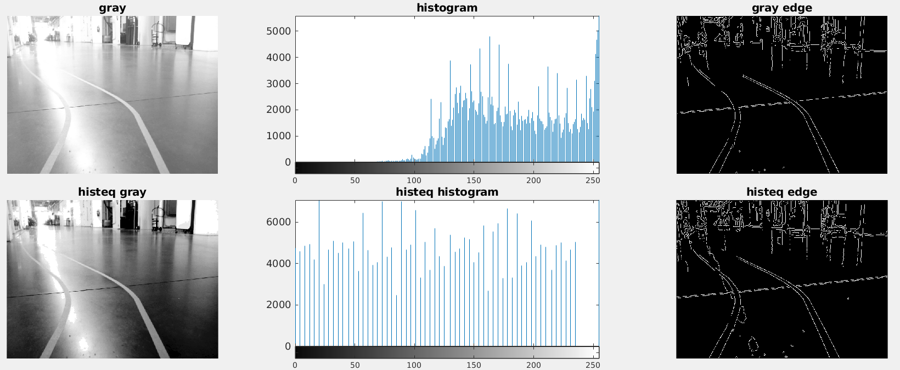
Histogram equalization

Slide 22
Summary of parameters/options
Camera Position | Exposure time | Edge detection | Rgb merge | Image rescale | denoise | Gamma correction | Histogram equalization
Top-back | 80 | sobel |  | 160x120 | Median filter | ?

Slide 23
Lane Extraction
Hough line transformation
Line segments merge

Slide 24
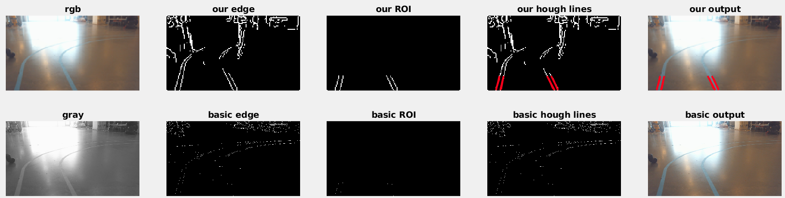
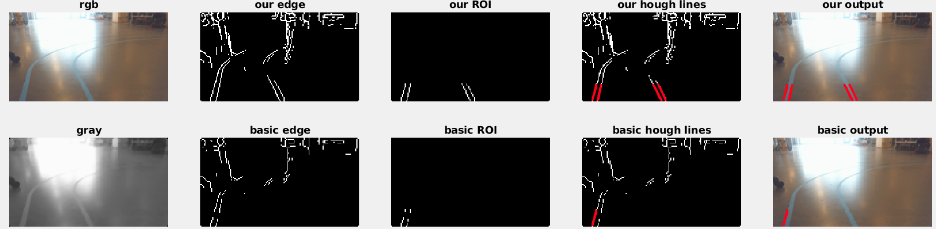
Hough Lines
All vs. none
All vs. no-rgb merge

Slide 25
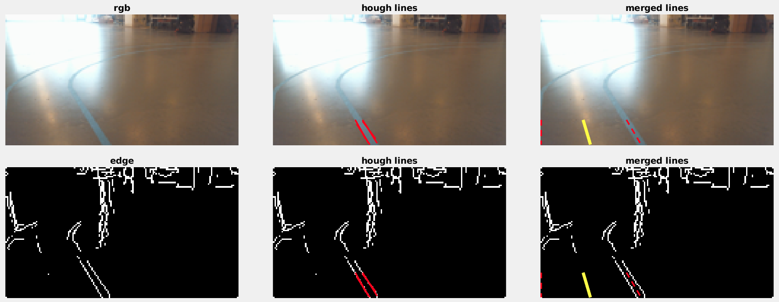
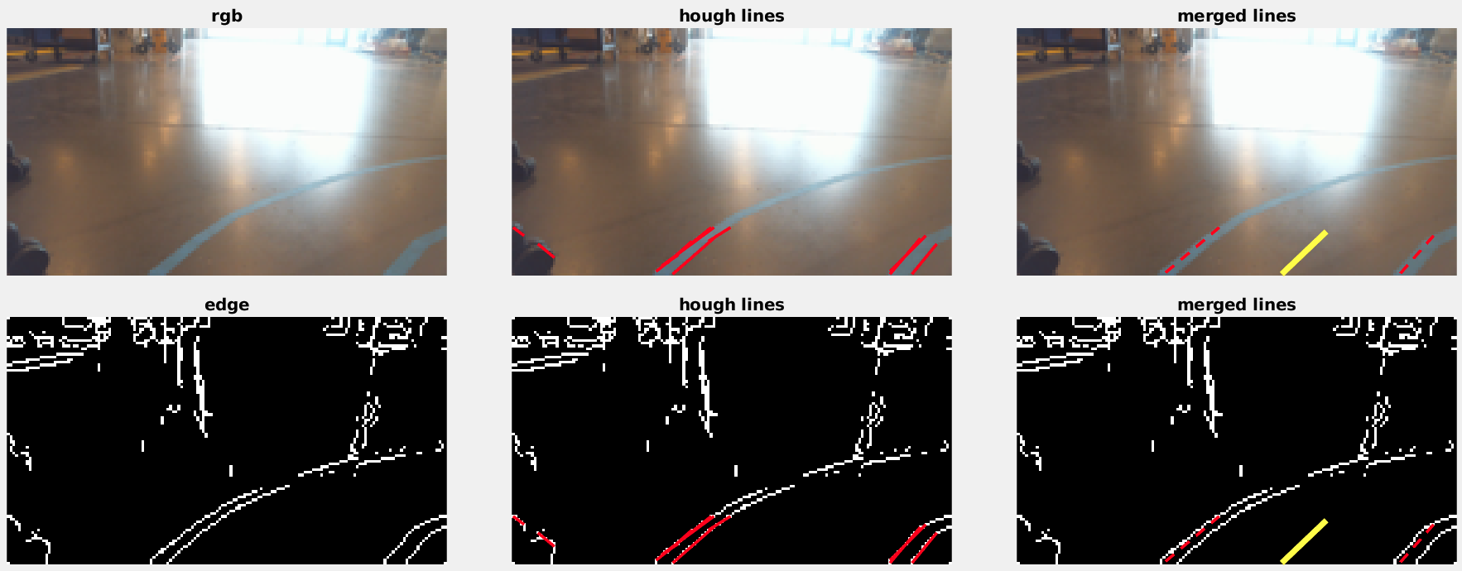
Road Lanes

Slide 26
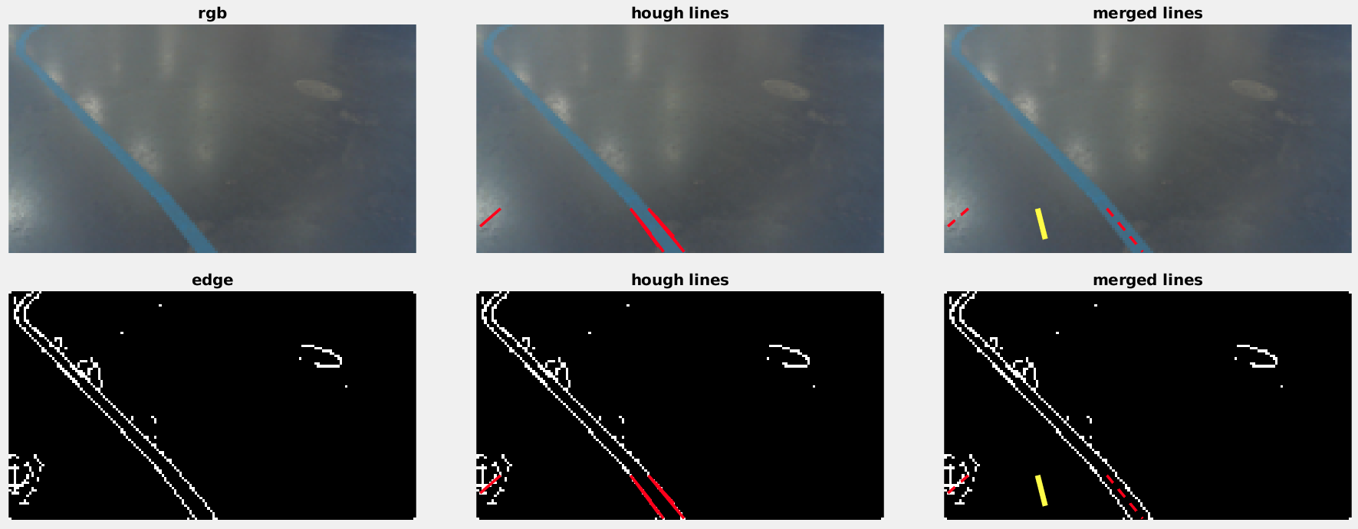
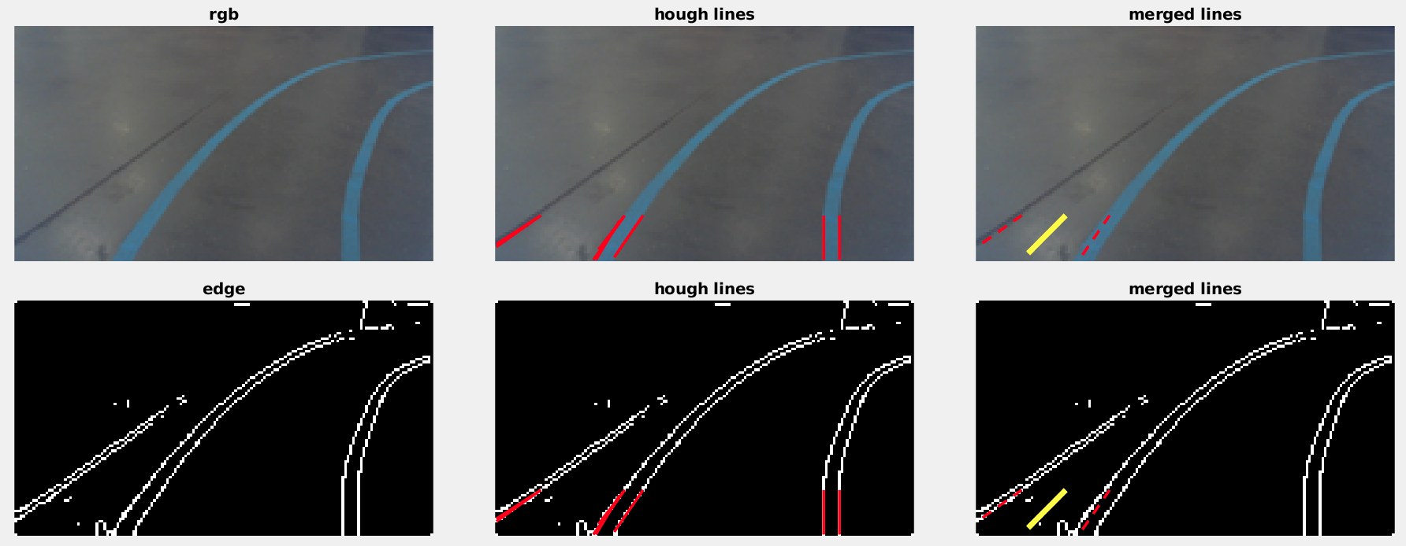
Corner cases
Check:
lane width
level of parallelism
Lane color consistency
p=[dmin, dmax, theta, colordiff]

Slide 27
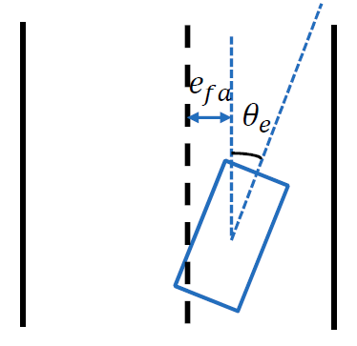
Vehicle Control
Steering Control:
Stanley
Pure Pursuit
PID controller by Blob Tracking
Speed Control:
Pulse Width Modulation
Loop Counter
Pause
Speed control by steering angle
Sign Detection Speed Control:
School sign
Stop Sign
Stanley Controller

Slide 28
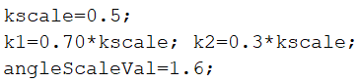
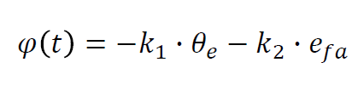
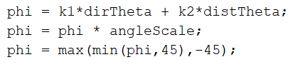
Stanley Controller
Simplified Version

Slide 29
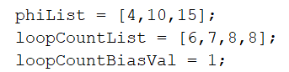
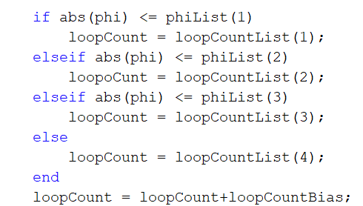
Speed Control
Steering angles:
Phi(1) = 4°
Phi(2) = 10°
Phi(3) = 15°
Vehicle Speed:
V1 = Loop Count 6
V2 = Loop Count 7
V3 = Loop Count 8
V4 = Loop Count 8

Slide 30
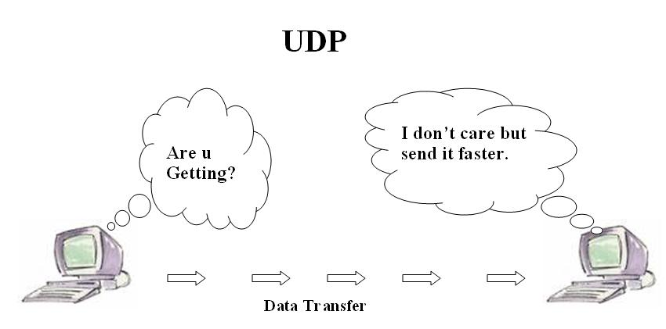
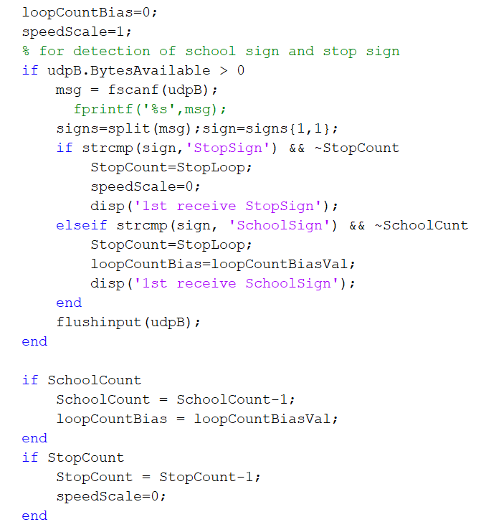
Sign Detection Speed Control User Datagram Protocol
Yet,
Faster than Transmission Control Protocol TCP
https://en.wikibooks.org/wiki/Communication_Networks/TCP_and_UDP_Protocols

Slide 31
Road Sign Recognition and Vehicle Reaction
Task: To detect the School Sign and Stop Sign
Implementation: Cascade Object Detector, Deep Learning Models (RCNN+classifier)
Challenges faced: Insufficient dataset, Detection of sign w.r.to color, sensitive to out of plane rotation. Requires huge dataset.

Slide 32
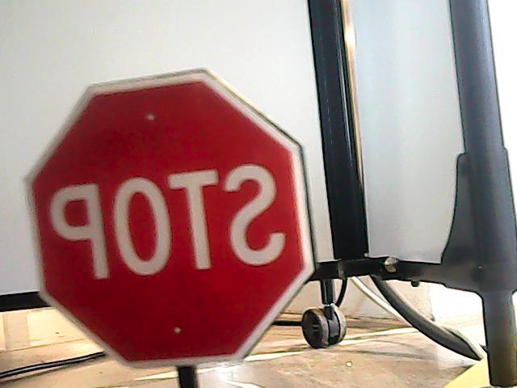
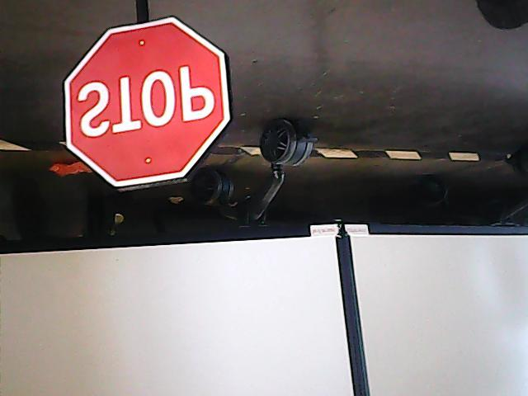
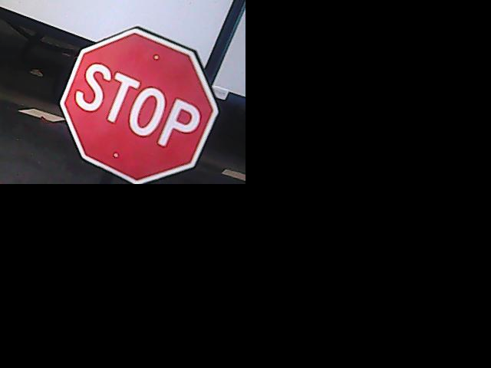






Data Augmentation
flip horizontal
flip vertical
Translate to [top|down, left|right]
Rotate [-15,15] degree

Slide 33




Cascade Detector - Stop Sign
3. Stop: 0.3, 20, stop at stage 12, accuracy = 81.89%
neg: 943, pos: 311, time: 0.048755, FPS: 20
4. Stop-0.1, 20, stop at stage 7, accuracy = 80.54
neg: 943, pos: 311, time: 0.049497, FPS: 20
Stop: 0.3, 10, accuracy = 72%
neg: 943, pos: 311, time: 0.049687, FPS: 20
Stop: 0.1, 10, accuracy = 81.89%
neg: 943, pos: 311, time: 0.049569, FPS: 20

Slide 34




Cascade Detector - School Sign
School-0.3-10, accuracy = 7.33%
neg: 358, pos: 896, time: 0.054726, FPS: 18
School-0.1-10, accuracy =
neg: 358, pos: 896, time: 0.055506, FPS: 18
3. School-0.3-20, stop at stage 9, accuracy =
neg: 358, pos: 896, time: 0.055255, FPS: 18
4. School-0.1-20, stop at stage 5
neg: 358, pos: 896, time: 0.055072, FPS: 18

Slide 35
RCNN + CNN models
CNN models | Layer # | performance | Time per second [s] | FPS
cifar10 | 15 | Many false positive | 0.15 | 6.7
alexnet | 25 | Many false positive | 0.6 | 1.7
resnet18 | 71 | accurate | 0.68 | 1.47
googlenet | 144 | accurate | 1.2 | 0.83
Cifar10:
High performance rate
High computational speed
High threshold values

Slide 36
Road Sign Recognition challenges
Sign angle changes, error in detecting the sign.
Delay in the communication between the computers.
Trained the model using multiple images by creating an almost double dataset.

